Slide 1
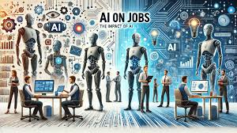
AI Replacing Jobs vs Creating New Careers
Pulkit Agrawal | Edunet Foundation – AICTE Internship

Slide 2
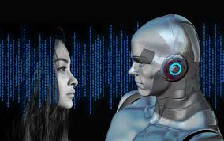
What’s Changing in the Labour Market
Automation is replacing repetitive, routine tasks.
AI is simultaneously generating new high‑skill roles.
India sees both automation in back‑end operations and rapid growth in AI‑driven startups.

Slide 3
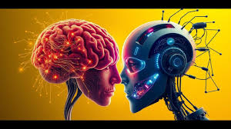
Key Expert Insights
AI augments more jobs than it eliminates.
Hybrid roles combining domain + AI skills are increasing.
Reskilling reduces displacement risk.
AI governance, auditing, and ethics roles are expanding.

Slide 4
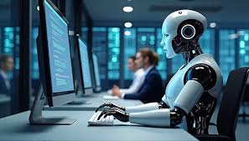
Recommendations & Way Forward
Build T-shaped skills: domain depth + AI literacy.
Expand reskilling & micro-learning programs.
Strengthen policy frameworks to make AI job-positive.

Slide 5
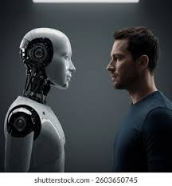
Sources
World Economic Forum – Future of Jobs Report
McKinsey Global Institute – AI & Workforce Studies
NITI Aayog – AI for All Report
Industry case studies & news insights

